Slide 1


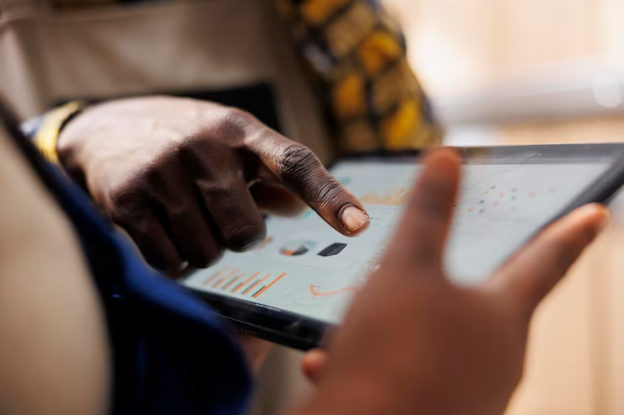


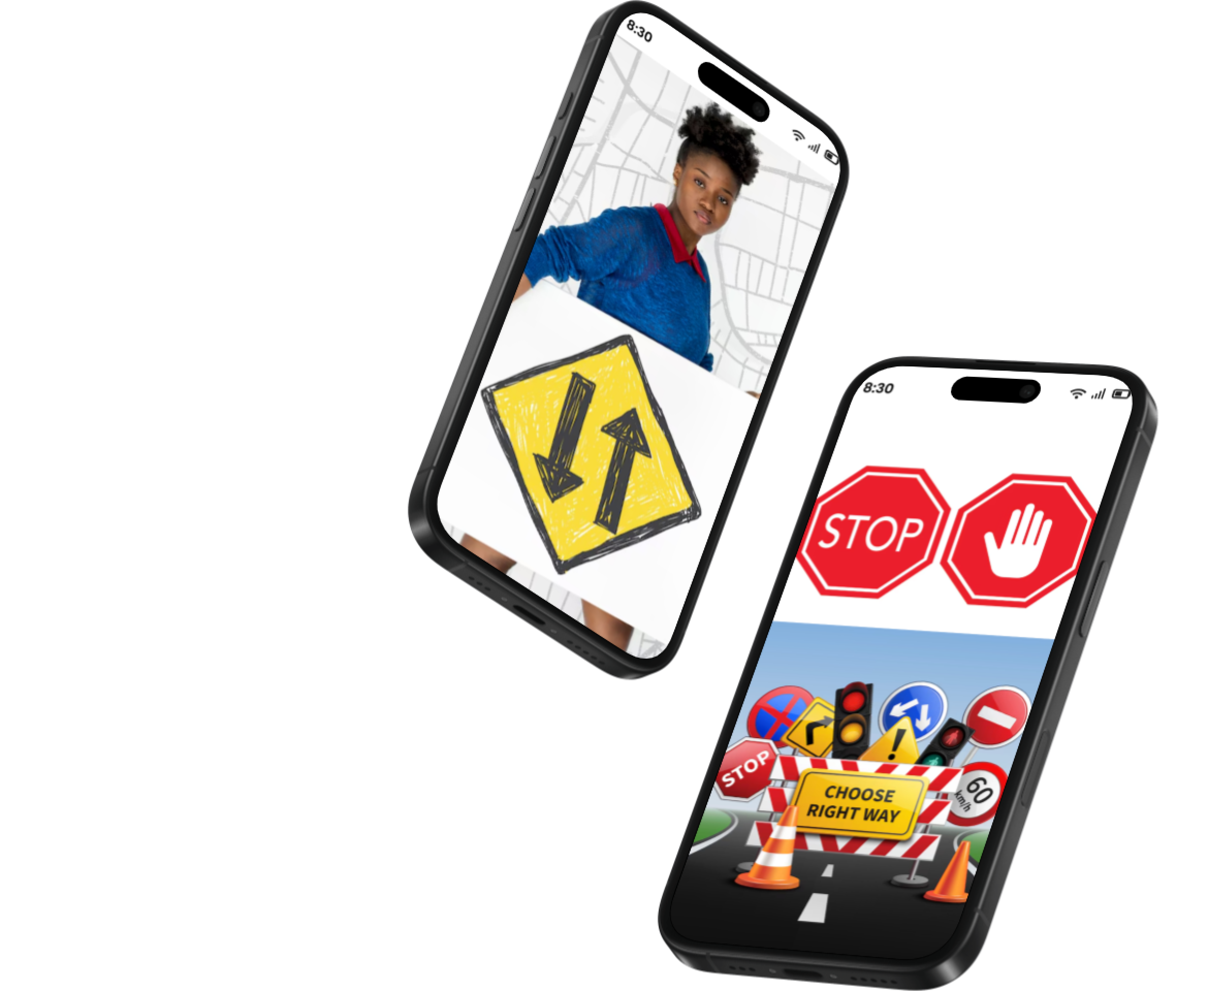

AGENDA

Slide 2




INTRODUCTION
1
This report outlines the requirements gathering phase for a mobile application designed to enhance road safety in Cameroon by providing road sign education and real-time road condition updates

Slide 3

METHODOLOGY
An online and offsite survey was conducted from April 11 to April 13, 2025, targeting a diverse group of road users in Cameroon,
Car Drivers
Bus Drivers
Taxi Drivers
Driving Schools
Pedestrians
Traffic Officers
2

Slide 4
STAKEHOLDER
ANALYSIS
3

Slide 5

1
Primary Users (Drivers: Private Car, Bus, Taxi, Motorbike)
Traffic Officers and Police Traffic Units
2
3
Other Users (Pedestrians, Driving Instructors):
Secondary Stakeholders (Traffic Authorities, Road Safety Organizations)
4

Slide 6
SURVEY
4
ANALYSIS

Slide 7

Respondent Demographic
Role
40%
Private car drivers
20%
Bus drivers
18%
Taxi drivers
4%
Traffic Officers/Police
2%
Motor bike riders
2%
Driving Instructors
2%
Pedestrians
Others
2%

Slide 8
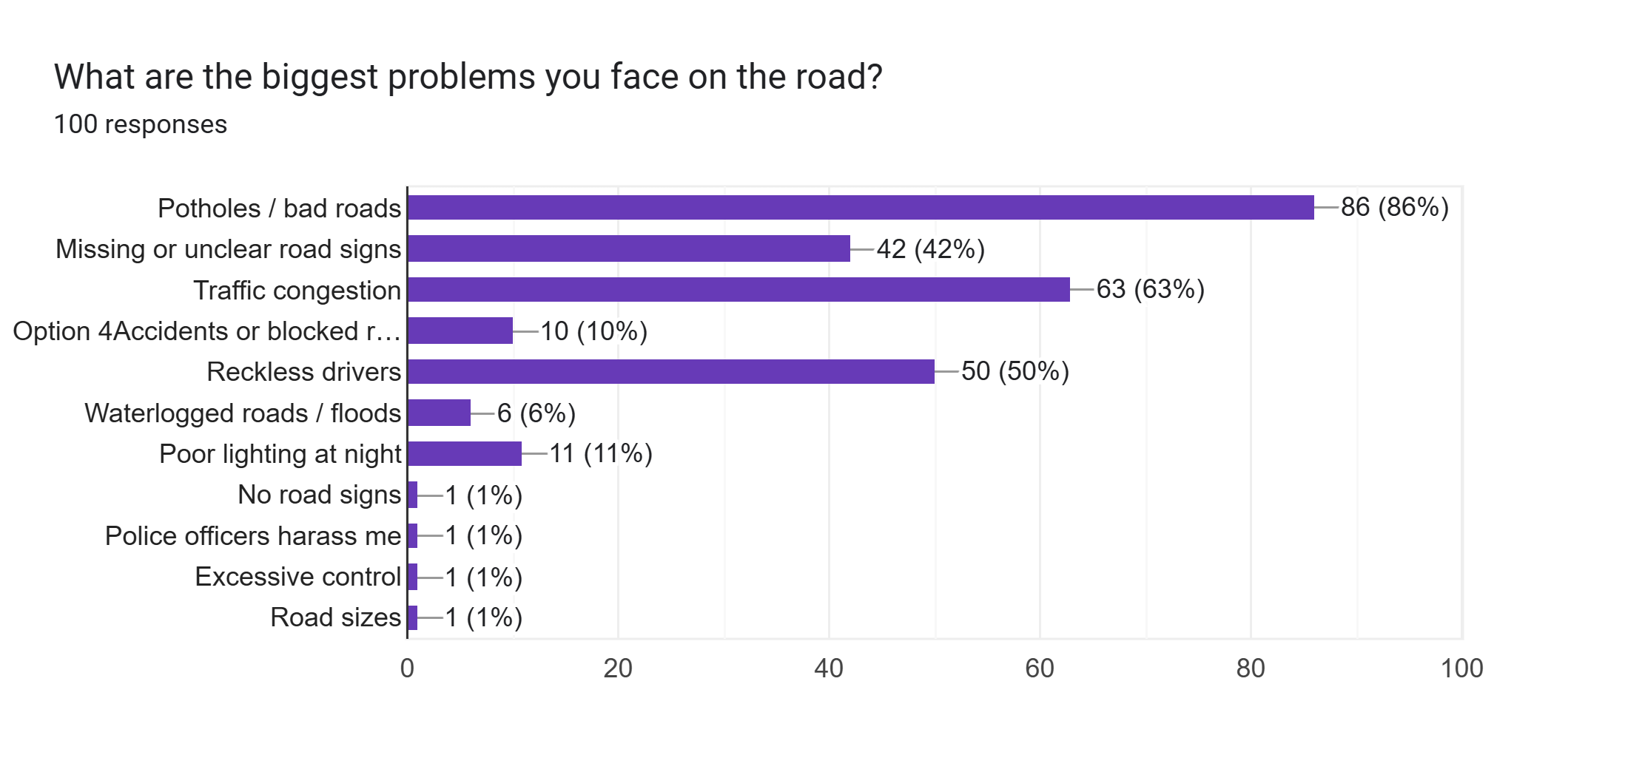
Road Challenges
Most Common Issues
Qualitative feedbacks
“Potholes are a nightmare, especially at night” (bus driver).
“Signs are often faded or covered by grass at bends” (private car driver).
“Reckless overtaking causes accidents and delays” (taxi driver)

Slide 9
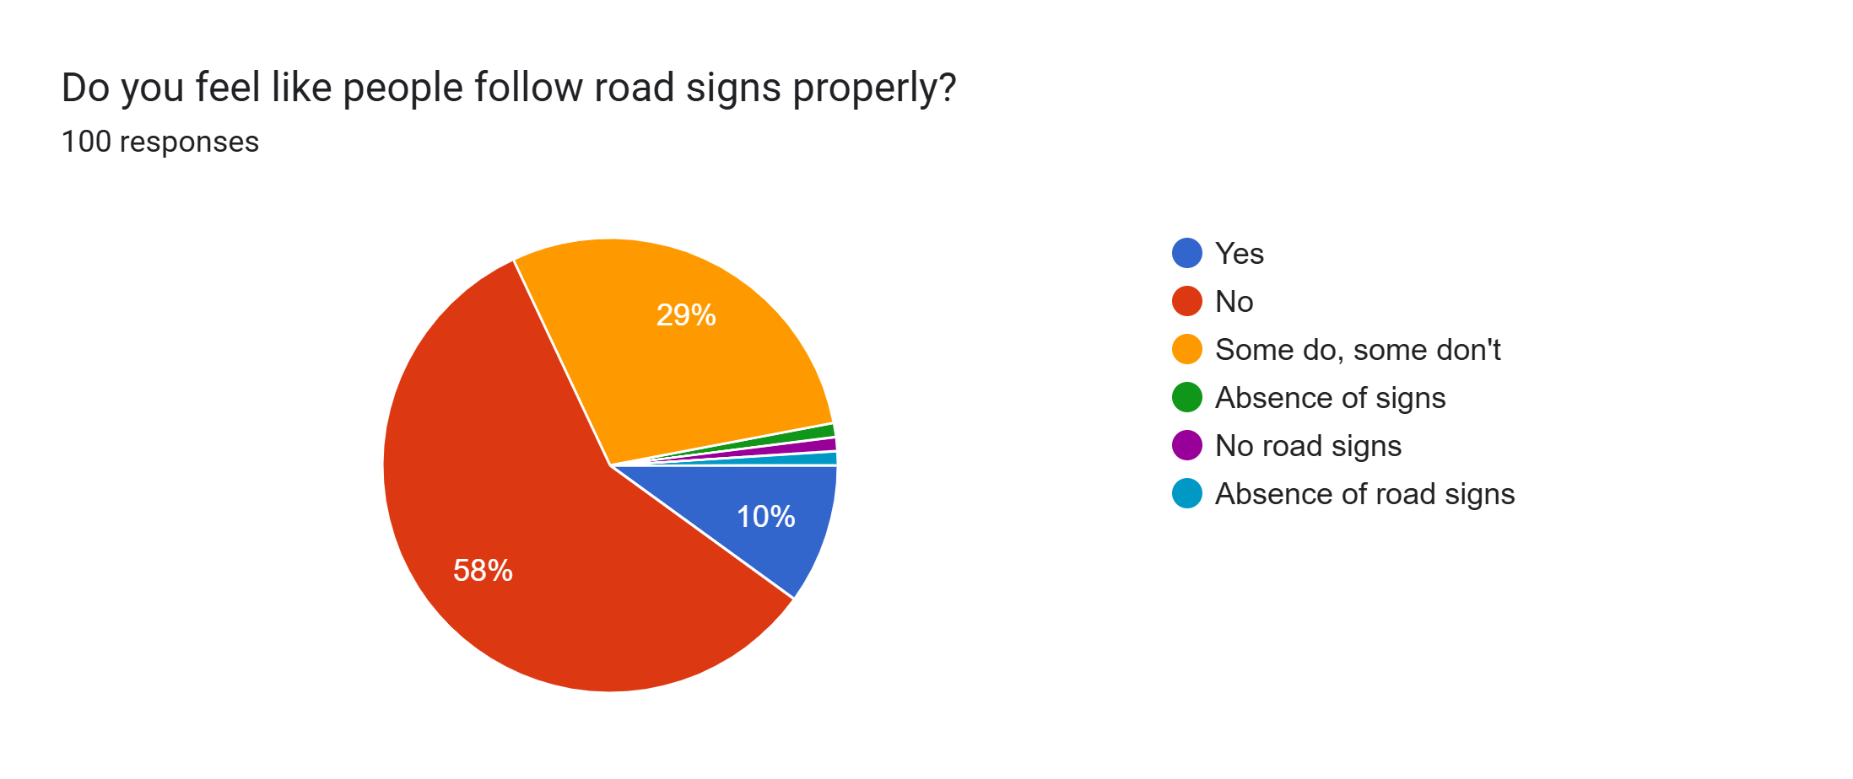
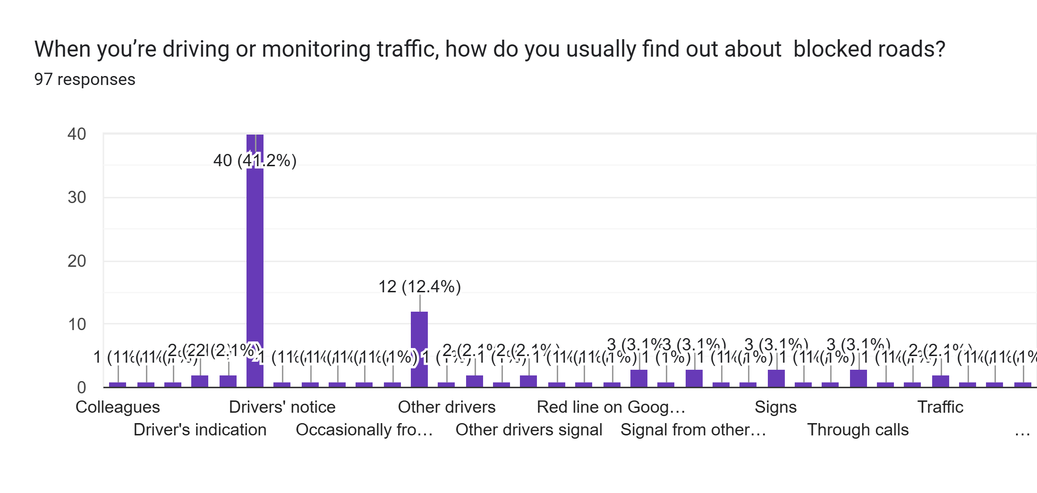
Road Signs Compliance
Information Sources

Slide 10
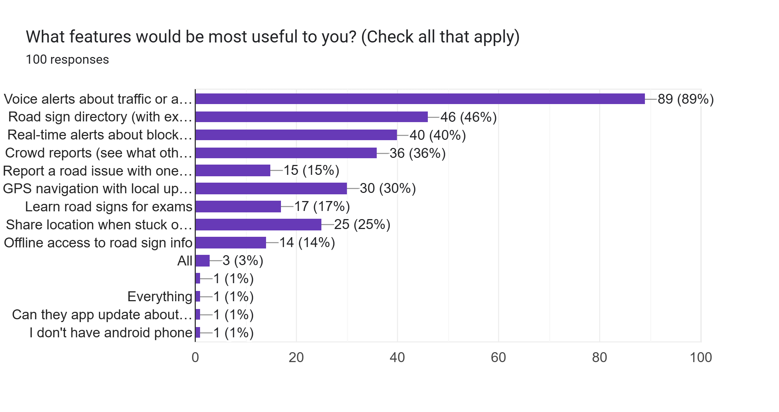
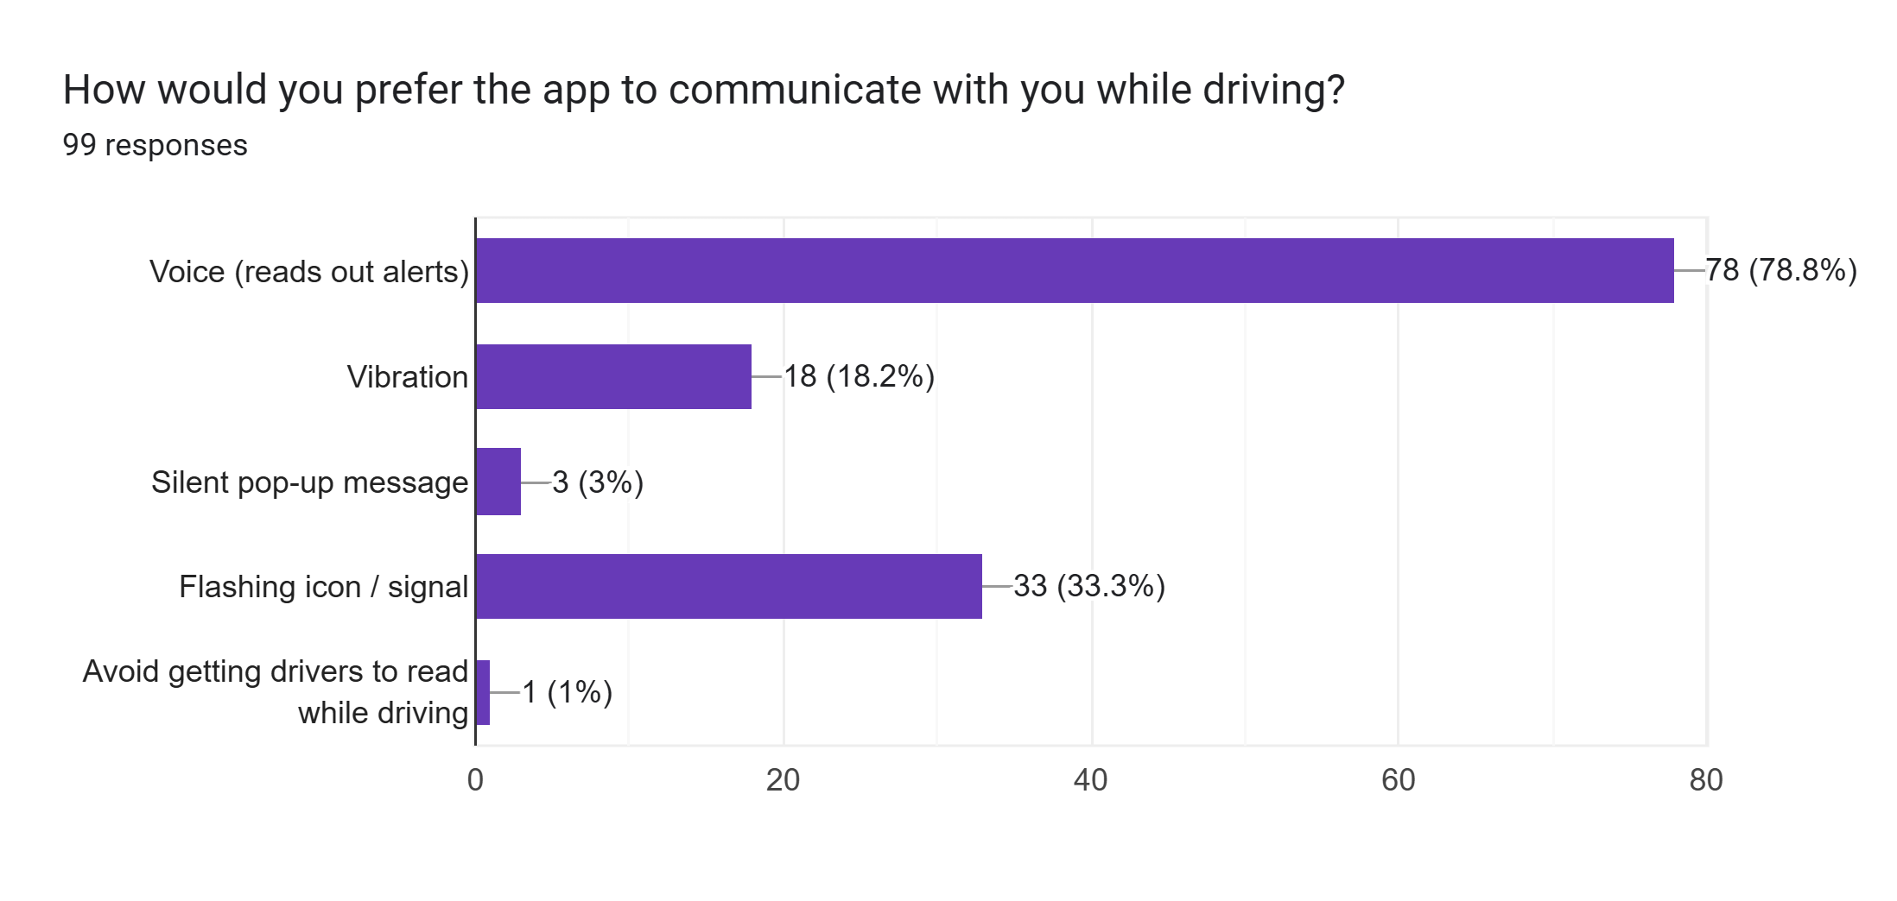
Desired App Features
Most Popular Features
Notification Preferences

Slide 11
FUNCTIONAL
5
REQUIREMENTS

Slide 12
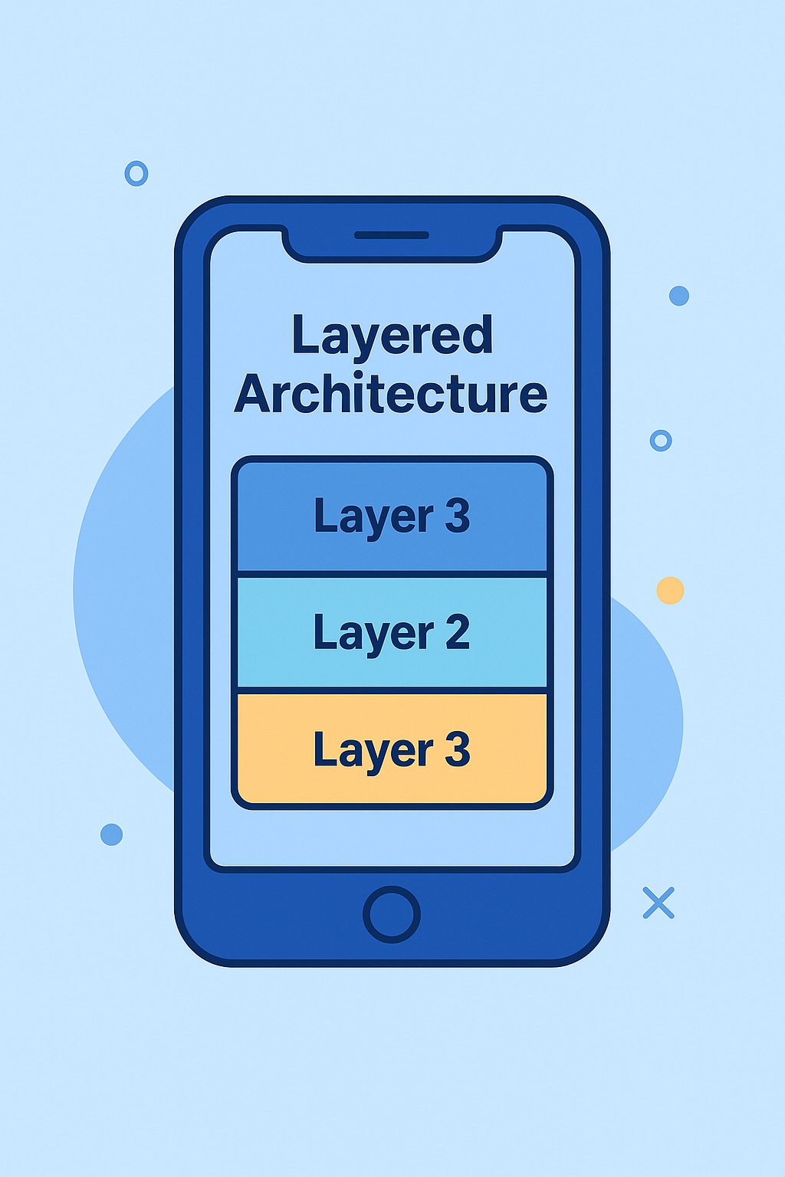



Key Features
Road Sign Directories
Crowd Reporting
Offline Mode
GPS Navigation
Location Sharing
Real Time Alerts
Customizable Notifications

Slide 13
NON-FUNCTIONAL
6
REQUIREMENTS

Slide 14
Factors
Usability
Performance
Safety
Reliability
Compatibility

Slide 15
PRIORITIZED
7
REQUIREMENTS

Slide 16

Road Signs Directory
2
Voice Alerts for Traffic/Accidents
1
3
Real-Time Condition Alerts
5
4
Offline Mode
Crowd Reporting Interface

Slide 17
Task Constraint/
8
Assumption

Slide 18
TASK CONSTRAINTS
TASK ASSUMPTIONS
Users Have Smart Phones With GPS
Limited Internet Access In Rural Areas
Traffic Authorities Will Provide Some Data
GPS Accuracy Issues In Dense Areas
Lack of Centralized Traffic Data

Slide 19
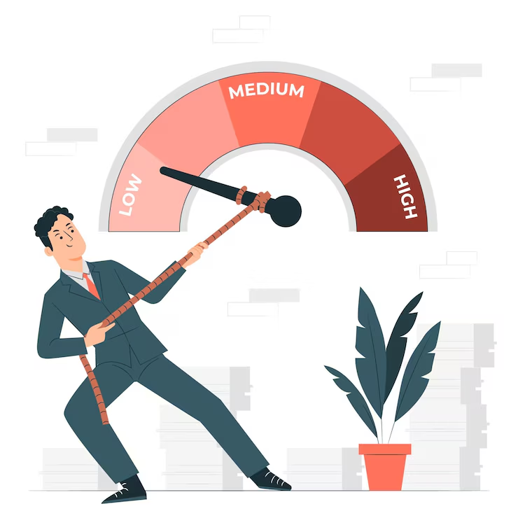
LIMITATIONS/ CONCLUSION
09

Slide 20

Thank You

